Slide 1
Learning Objective
Today we will begin learning about budgeting and
the differences between needs and wants.
Agenda:
1. Dates to remember
2. Key Words
3. Learning Exercise
4. Homework

Slide 2
This Week’s Announcements
Monday, September 7- Labor Day Holiday for BISD and ACC
Tuesday, September 8- BISD Holiday, but ACC still has classes
Tuesday, September 29- FAFSA Informational Meeting 6-7 PM
Wednesday, September 30- BEST College Night

Slide 3
Key Words
Gross Income- Total pay before taxes are deducted.
Net Income- Pay after taxes are deducted.
Taxes- money a person has to pay to local, state, or federal government for public services, such as roads, police, military, schools, etc.
Budget- a written plan to spend your money.
Debt- money that is owed or due.
Loan- money that is borrowed and will need to be repaid, typically with interest, ex. school loan, mortgage (loan to purchase a house), or car loan.
Interest- the charge for borrowing money. For example, for a $100 loan if the interest is 6%, you would need to pay back the $100 plus $6 for the loan.

Slide 4
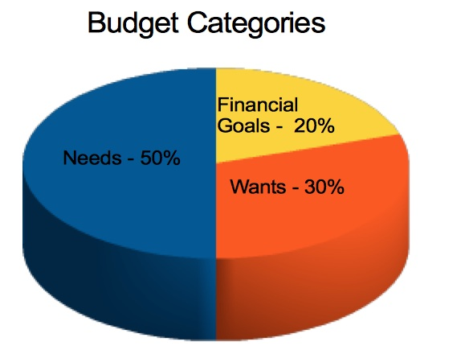
Budgeting Example
Let’s look at budgeting. As discussed last class, a budget tracks where your money is going, so that you do not spend more than you make, and allows you to save for something big, such as a car or college.
Here is an example of a good budgeting idea- the 50/30/20.
50% for needs such as car payment, car insurance, gas, school books, cell phone.
30% for wants such as eating out, going to the movies.
20% for financial goals such as saving for college or a car.

Slide 5
Budgeting Example
Here is a budget I created for a high school student using the 50/30/20. This student works 20 hours a week at HEB, making $10 an hour, his parents pay for his car, housing, and groceries, although he has to pay for his car insurance and gasoline, and he is trying to save for college. Texas Reality Check
Gross Income | $800 | 20 hours x 10 hours x 4 weeks =$800
Taxes | ($200) | Most people plan on taxes taking 25% of income
Net Income | $600
Savings | ($120) | 20% of $600= $120 $480 is left.
Fun | ($180) | 30% of $600= $180 $300 is left. Eating out, spending time with friends, senior trip.
Car insurance | ($100) | Car insurance for a high school is expensive. $200 is left
Gasoline | ($30) | $170 is left.
Cell Phone | ($60) | $110 is left.

Slide 6
Budgeting Example
This student had $110 left, which he could add to his college savings or pay for something else.
Of course, he does not have to pay for rent, groceries, or a car payment.

Slide 7
Insurance
Required
Car Insurance- Liability
Health Insurance- currently allowed to be on parents’ plan until age 26
Homeowner’s Insurance if you have a mortgage
Not Required
Dental
Vision Insurance
Car Insurance- Comprehensive
Life Insurance
Burial Insurance
Rental/ Home Insurance
Flood Insurance

Slide 8
Homework
Tracking your expenses for one week.
Using what you have learned, create a simple budget.
What would you save money for?

